Slide 1
AI Agents in the Data Pipeline: Transforming Data Operations From Ingestion to Insight
Enhancing data flow with intelligent automation and insight
Notes:
AI-generated content may be incorrect. --- This presentation explores how AI agents revolutionize data pipelines, enhancing the journey from raw data ingestion to actionable insights. We will cover foundational concepts, AI integration, automation, real-world applications, and future trends including ethical considerations.

Slide 2

Agenda Highlights
Foundations of Data Pipelines
Role of AI Agents in Data Pipelines
AI-Driven Automation Across the Pipeline
Case Studies and Real-World Applications
Future Trends and Ethical Considerations
Notes:
--- We will begin with the basics of data pipelines, then explore the role of AI agents within these systems. Next, we focus on AI-driven automation, followed by case studies highlighting real-world applications. Finally, we'll discuss future trends and ethical challenges in AI-powered data pipelines. Image source: Microsoft 365 content library

Slide 3
Foundations of Data Pipelines
Notes:
Understanding the core structure and function of data pipelines is essential before exploring AI integration. We’ll discuss definitions, key components, pipeline stages, and common challenges faced in managing data workflows.

Slide 4

Definition and Key Components of a Data Pipeline
Data Pipeline Definition
A data pipeline moves data sequentially from source to destination through structured processes.
Data Ingestion
The data ingestion layer collects and imports raw data into the pipeline for further processing.
Data Processing
Processing transforms and cleans data to prepare it for storage and analysis.
Storage and Analysis
Data is stored efficiently and analyzed to extract meaningful insights.
Notes:
--- A data pipeline is a series of processes that move data from source to destination. Key components include data ingestion, processing, storage, and analysis layers, ensuring smooth and structured data flow. Image source: Microsoft 365 content library

Slide 5

Stages of a Typical Data Pipeline
Data Collection and Ingestion
Data collection gathers raw data, while ingestion transfers it into processing systems efficiently.
Data Cleaning and Transformation
Cleaning removes errors and inconsistencies; transformation reshapes data for meaningful analysis.
Storage and Analysis
Processed data is stored securely and analyzed or visualized to support business decisions.
Notes:
--- Typical stages include data collection, ingestion, cleaning, transformation, storage, and finally analysis or visualization. Each stage plays a critical role in preparing data for business intelligence. Image source: Microsoft 365 content library

Slide 6
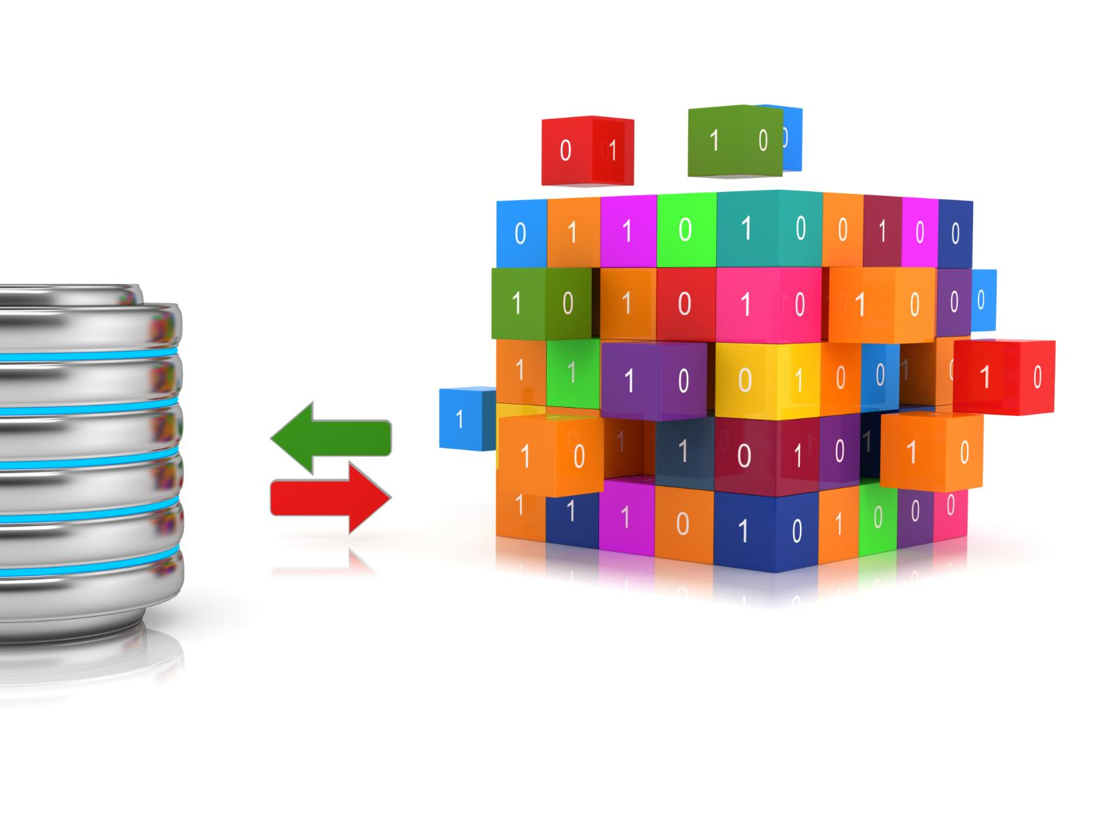
Traditional Challenges in Data Pipeline Management
Data Silos
Data silos restrict data sharing across departments, limiting comprehensive analytics and insights.
Scalability Issues
Pipeline scalability issues reduce the ability to handle growing data volumes efficiently.
Latency and Delays
High latency in data processing impacts timely delivery of critical business insights.
Manual Intervention and Errors
Manual steps increase error risks and reduce pipeline reliability and automation benefits.
Notes:
--- Challenges such as data silos, scalability issues, latency, error detection, and manual intervention often hinder efficient pipeline operations, impacting data quality and timeliness. Image source: Microsoft 365 content library

Slide 7
Role of AI Agents in Data Pipelines
Notes:
AI agents are increasingly integrated into data pipelines to enhance automation, monitoring, and decision-making across workflows. This section introduces their function, types, and advantages.

Slide 8

What Are AI Agents and How Do They Function
Autonomous Programs
AI agents operate independently to perform tasks without continuous human control or supervision.
Data Processing
These agents analyze and interpret large datasets efficiently to extract meaningful information.
Anomaly Detection
AI agents identify unusual patterns or irregularities in data to alert for potential issues.
Decision-Making
AI agents make informed decisions based on data analysis to perform tasks effectively.
Notes:
--- AI agents are autonomous programs that use artificial intelligence to perform tasks such as data processing, anomaly detection, and decision-making with minimal human intervention. Image source: Microsoft 365 content library

Slide 9

Types of AI Agents Used in Data Workflows
Rule-Based Systems
Rule-based systems operate on predefined logic to automate decision-making in data workflows efficiently.
Machine Learning Models
Machine learning models learn from data patterns to improve predictions and automate complex tasks.
Reinforcement Learning Agents
Reinforcement learning agents optimize decisions through trial and error to maximize rewards in workflows.
Natural Language Processing Bots
NLP bots understand and generate human language to automate communication and data extraction.
Notes:
--- Common AI agents include rule-based systems, machine learning models, reinforcement learning agents, and natural language processing bots, each serving specific pipeline functions. Image source: Microsoft 365 content library

Slide 10

Benefits of Integrating AI Agents Into Pipelines
Enhanced Efficiency and Accuracy
AI agents streamline processes by reducing manual tasks and improving precision in pipeline operations.
Real-Time Response and Scalability
AI agents enable immediate reactions to changes and support scalable pipeline performance.
Anomaly Detection and Self-Healing
AI agents detect issues early and trigger self-healing mechanisms to maintain pipeline health.
Notes:
--- AI agents improve efficiency, accuracy, scalability, and enable real-time responses. They reduce manual efforts, detect anomalies early, and support self-healing mechanisms within pipelines. Image source: Microsoft 365 content library

Slide 11
AI-Driven Automation Across the Pipeline
Notes:
AI automates critical pipeline stages including ingestion, validation, cleaning, transformation, and monitoring, creating robust and adaptive data workflows.

Slide 12

Automating Data Ingestion and Validation
Dynamic Data Ingestion
AI agents automatically handle data collection from multiple diverse sources dynamically and efficiently.
Real-Time Data Validation
The system performs continuous validation to ensure data consistency and correctness during ingestion.
Ensuring Data Quality
Automated checks guarantee data completeness and integrity before further processing.
Notes:
--- AI agents can dynamically manage data ingestion from multiple sources and perform real-time validation to ensure data consistency and completeness before processing. Image source: Microsoft 365 content library

Slide 13
Automating Data Ingestion and Validation
Dynamic Data Ingestion
AI agents automatically handle data collection from multiple diverse sources dynamically and efficiently.
Real-Time Data Validation
The system performs continuous validation to ensure data consistency and correctness during ingestion.
Ensuring Data Quality
Automated checks guarantee data completeness and integrity before further processing.
Notes:
--- AI agents can dynamically manage data ingestion from multiple sources and perform real-time validation to ensure data consistency and completeness before processing. Image source: Microsoft 365 content library

Slide 14

AI-Based Data Cleaning and Transformation
Error Detection and Correction
AI agents use machine learning to identify and correct errors in datasets automatically, enhancing data accuracy.
Missing Data Imputation
AI fills in missing values by learning patterns, ensuring completeness and usability of data.
Data Format Transformation
AI transforms diverse data formats into standardized forms, enabling seamless analysis and integration.
Notes:
--- Using machine learning, AI agents identify and correct errors, fill missing values, and transform data formats, improving data quality and readiness for analysis. Image source: Microsoft 365 content library

Slide 15

AI in Monitoring, Error Detection, and Self-Healing
Continuous Pipeline Monitoring
AI agents provide real-time monitoring of pipeline health to ensure efficient and uninterrupted operation.
Anomaly and Failure Detection
AI detects anomalies and failures early to prevent major issues and reduce downtime.
Automated Corrective Actions
Some AI systems can self-heal by triggering automatic corrective actions, minimizing operational interruptions.
Notes:
--- AI agents continuously monitor pipeline health, detect anomalies or failures, and in some cases automatically trigger corrective actions to minimize downtime. Image source: Microsoft 365 content library

Slide 16
Case Studies and Real-World Applications
Notes:
We will examine how enterprises apply AI agents in their data operations, highlighting successes in anomaly detection, data quality improvements, and challenges encountered.

Slide 17

AI Agents in Large-Scale Enterprise Data Operations
Scaling Data Workflows
AI agents enable scaling of data workflows to process large volumes efficiently in enterprise environments.
Managing Complex Pipelines
AI agents handle complex data pipelines, ensuring smooth coordination and integration across multiple systems.
Enhancing Operational Efficiency
AI-driven automation improves operational efficiency by reducing manual intervention and optimizing processes.
Notes:
--- Leading organizations deploy AI agents to scale data workflows, manage complex pipelines, and enhance operational efficiency across distributed systems. Image source: Microsoft 365 content library

Slide 18

Success Stories in Anomaly Detection and Data Quality
Early Anomaly Detection
AI enables early identification of anomalies, reducing risks and preventing costly operational failures.
Data Quality Maintenance
AI continuously monitors and maintains high data quality to support accurate decision-making.
Cost Prevention and Timely Decisions
Improved anomaly detection and data quality help prevent costly errors and enable timely, informed decisions.
Notes:
--- Examples demonstrate how AI has improved early anomaly detection and maintained high data quality, preventing costly errors and enabling timely decisions. Image source: Microsoft 365 content library

Slide 19

Challenges and Lessons Learned From Deployments
Integration Complexity
Deploying AI systems involves complexities integrating with existing infrastructure and workflows.
Model Accuracy and Bias
Ensuring model accuracy and mitigating data biases are critical for reliable AI deployment.
Workforce Adaptation
Adapting workforce skills and processes is essential to effectively work alongside AI technologies.
Continuous Monitoring
Ongoing monitoring ensures AI systems maintain performance and adapt to changing conditions.
Notes:
--- Common challenges include integration complexity, model accuracy, data biases, and workforce adaptation. Lessons emphasize continuous monitoring and human-AI collaboration. Image source: Microsoft 365 content library

Slide 20
Future Trends and Ethical Considerations
Notes:
Looking ahead, emerging AI technologies promise to further transform data pipelines. This section also addresses critical ethical topics such as bias, privacy, transparency, and human oversight.

Slide 21

Emerging Technologies in AI-Powered Data Pipelines
Explainable AI
Explainable AI improves transparency and understanding of AI decisions within data pipelines.
Edge Computing
Edge computing enables faster data processing by performing computations near data sources.
Reinforcement Learning
Advanced reinforcement learning enhances automation and adaptability in data pipelines.
Notes:
--- Innovations like explainable AI, edge computing, and advanced reinforcement learning are set to enhance pipeline automation, adaptability, and intelligence. Image source: Microsoft 365 content library

Slide 22

Addressing Bias, Privacy, and Transparency
Bias Identification and Mitigation
Identifying and reducing biases in AI models is essential for fair and ethical technology deployment.
Ensuring Data Privacy
Protecting user data and complying with privacy regulations is crucial for ethical AI implementation.
Transparency in AI Decisions
Maintaining clear and explainable AI decision-making processes builds trust and accountability.
Notes:
--- Ethical deployment requires identifying and mitigating biases, ensuring data privacy compliance, and maintaining transparency in AI decision processes within pipelines. Image source: Microsoft 365 content library

Slide 23

The Evolving Role of Human Oversight
Importance of Human Expertise
Human expertise is essential to oversee AI systems and ensure they function responsibly and effectively.
Validation of AI Outputs
Humans validate AI outputs to maintain accuracy and reliability in data-driven decisions.
Strategic Decision Making
Human judgment is crucial for making strategic decisions for responsible data pipeline management.
Notes:
--- Despite advances, human expertise remains vital to oversee AI systems, validate outputs, and make strategic decisions to ensure responsible and effective data pipeline management. Image source: Microsoft 365 content library

Slide 24
Conclusion
AI Automation in Data Pipelines
AI agents automate data processes to improve efficiency and speed up data insights.
Enhancing Data Quality
Automation helps enhance data accuracy and reliability across data operations.
Ethical Responsibility and Oversight
Balancing innovation with ethics and human oversight is crucial for successful AI deployment.
Notes:
AI agents are reshaping data pipelines by automating processes, enhancing data quality, and enabling faster insights. As technology evolves, balancing innovation with ethical responsibility and human oversight will be key to successful data operations.

